Slide 1
UNO iSTEM Internet of Things (IoT)
Spring 2019- DogBowl Activity
Notes:
NOTES ABOUT THIS TEMPLATE
A design theme has been created for ease of use and consistency. Within the theme the background, font choice, and colors have been preset.
FONT: the font is set to Arial. Keep within this font family to ensure consistency within document and when opening on various computers.
COLORS: only use UNO designated colors which have been made into swatches and can be found under ”theme colors”
COPY: use textboxes to add copy to each new slide
LAST SLIDE: the last slide features the Lock-up and a combination of the Non-discrimination and accessibility statements. Please keep this at the end of your presentation in order to meet university brand policies.

Slide 2
Welcome Back!
Agenda:
DogBowl Activity Introduction
Discuss DogBowl Activity components and Downloads
Reflection

Slide 3
DogBowl Activity:
What is this activity about?
What kind of real world problems could we solve with with a project like this?
Image: https://github.com/SachinPawaskarUNO/IoT-DogBowl/raw/master/Images/wb.jpg
IoT-DogBowl project which uses water level sensor with Node MCU and Wifi connection to Blynk app

Slide 4
DogBowl Activity:
Hardware you will need:
NodeMCU Esp8266
Female/Female Jumper Wires
Water Sensor
Image: https://github.com/SachinPawaskarUNO/IoT-DogBowl/raw/master/Images/1.jpg

Slide 5
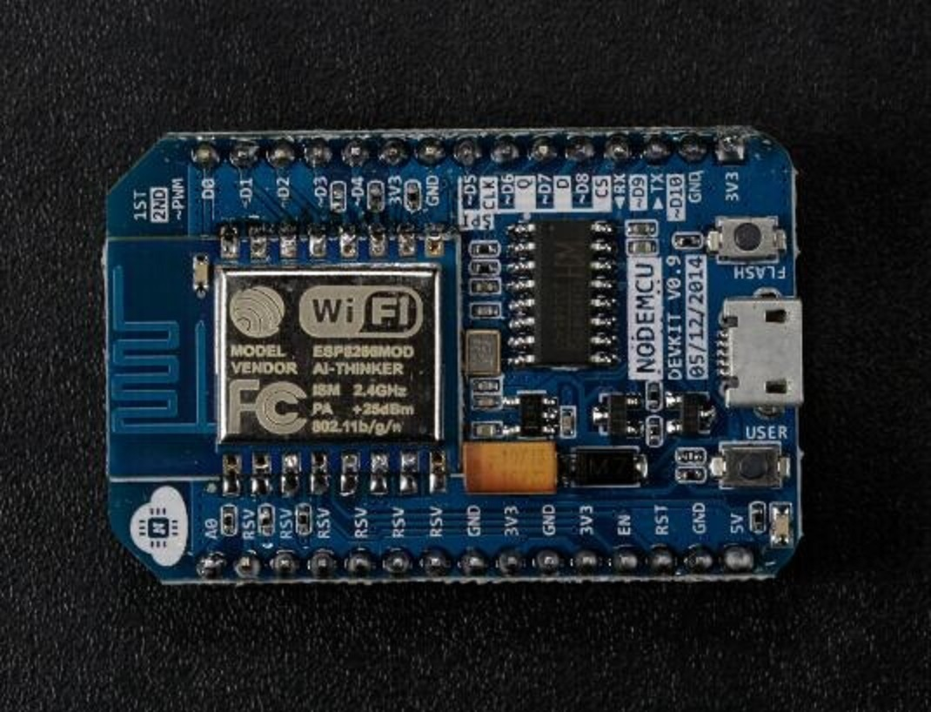
DogBowl Activity
NodeMCU Esp8266: Excellent choice for IoT projects of all kinds.
IoT development board with built in Wi-Fi.
Works like a mini-computer that can connect to and be programmed by a standard PC or Mac.
(“Getting to know NodeMCU”, n.d.)
Image: https://wdc.objectstorage.softlayer.net/v1/AUTH_7046a6f4-79b7-4c6c-bdb7-6f68e920f6e5/Code-Tutorials/iot-nodemcu-open-why-use/images/Picture1.png
https://developer.ibm.com/tutorials/iot-nodemcu-open-why-use/

Slide 6
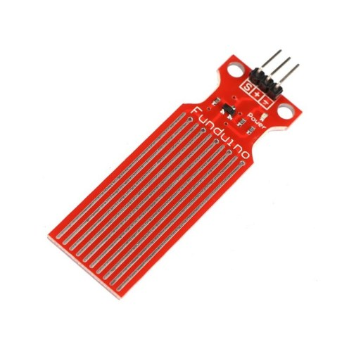
DogBowl Activity
Water Level Sensor:
Designed to measure the level of flow substances like liquids, slurries and granular materials.
Can be found in
Nuclear power plants
Automobiles for measuring the amount of gasoline left in the fuel tank
Engine oil, cooling water, and brake/power steering fluid.
(“What is a Water Sensor?”, 2013)
Image: https://i1.wp.com/www.teachmemicro.com/wp-content/uploads/2018/04/water-level-sensor.jpg?w=800&ssl=1

Slide 7
DogBowl Activity
The Setup:
To connect the water sensor follow the chart above. The red letters represent the water sensor and the black sensors represent the Arduino. The different colored lines are the wires.
Image: https://github.com/SachinPawaskarUNO/IoT-DogBowl/raw/master/Images/Wires.png

Slide 8
DogBowl Activity:
Software you will need:
Arduino IDE and Arduino drivers
Blynk app and Library
VCP driver
Excel
Images: http://news.silabs.com/image/logogallery.thumbnail.png, https://d12oh4b377r949.cloudfront.net/places/8bbb8ac8-688e-4a78-b352-24b480d13b5f/19678aac-3e67-47db-9672-82a7c39989c3_logo, http://blog.arduino.cc/wp-content/uploads/2013/07/Arduino_logo_pantone.png, https://teaching.cambriancollege.ca/wp-content/uploads/2018/07/Top-of-Page-Images.jpg

Slide 9
DogBowl Activity:
Arduino IDE
The open-source Arduino Software (IDE) used for writing and uploading code to the development board
(“Arduino - Software”, n.d)
Image: https://cdn.sparkfun.com/assets/a/b/a/f/5/51363844ce395f9922000001.png, http://blog.arduino.cc/wp-content/uploads/2013/07/Arduino_logo_pantone.png

Slide 10
DogBowl Activity:
Blynk
Popular and easy mobile app for working with IoT projects.
The Blynk Library establishes communication between your hardware, Blynk Cloud and Blynk Apps.
(“How to install Blynk Library for Arduino’, n.d. )
Image: https://d12oh4b377r949.cloudfront.net/places/8bbb8ac8-688e-4a78-b352-24b480d13b5f/19678aac-3e67-47db-9672-82a7c39989c3_logo, https://github.com/SachinPawaskarUNO/IoT-DogBowl/raw/master/Images/5b.png, https://github.com/SachinPawaskarUNO/IoT-DogBowl/raw/master/Images/5c.png

Slide 11
DogBowl Activity
The Setup:
Image: https://github.com/SachinPawaskarUNO/IoT-DogBowl/raw/master/Images/1.jpg

Slide 12
Reflection
What did you learn today?
Did you like the activity?
Feedback

Slide 13
References
Arduino - Software. (n.d.). Retrieved February 6, 2019, from https://www.arduino.cc/en/Main/Software
Getting to know NodeMCU and its DEVKIT board – IBM Developer. (n.d.). Retrieved February 6, 2019, from https://developer.ibm.com/tutorials/iot-nodemcu-open-why-use/
How to install Blynk Library for Arduino. (n.d.). Retrieved February 6, 2019, from http://help.blynk.cc/getting-started-library-auth-token-code-examples/how-to-install-blynk-library-for-Arduino
Pawaskar, S. (2018). IoT-DogBowl project which uses water level sensor with Node MCU and Wifi connection to Blynk app: SachinPawaskarUNO/IoT-DogBowl. Retrieved from https://github.com/SachinPawaskarUNO/IoT-DogBowl (Original work published 2018)
What is a Water Sensor? (2013, June 20). Retrieved February 6, 2019, from https://www.azosensors.com/article.aspx?ArticleID=225
Notes:
DO NOT DELETE THIS SLIDE. Please keep at the end of your presentation.

